Slide 1
Customer Churn Analysis
Lucky Suman

Slide 2
Business Understanding & Overview
We have data set of customers along with column of churn status. We will use Exploratory Data Analysis in order to get actionable insights convert them into meaningful stories and present it so that company can take necessary actions to reduce the churn rate of customers by retaining them.

Slide 3
Understanding the data

Slide 4
Target Variable
Customers who have churned: 1869
Customers who are active: 5174
So 26.5% of total customers were churned.
We have to analyze all the features with respect to churn rate to get some insights to find who are high churners.

Slide 5
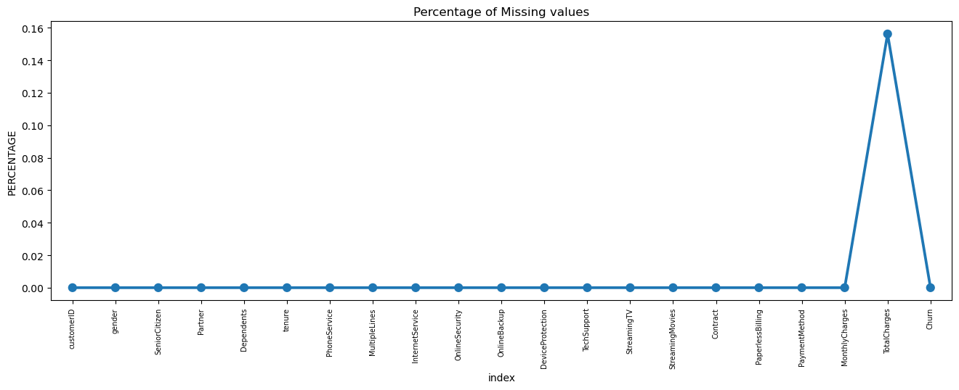
Initial Intuition and Missing Data
Here, we don't have any missing data initially.
After converting the column total charges to numerical, we found that 11 rows have missing data.
As only 0.16% of 7043 rows have missing data which is very little, we found it better to drop those 11 rows.
We have divided the customers into bins based on tenure e.g. for tenure < 12 months: assign a tenure group if 1-12, for tenure between 1 to 2 Years, tenure group of 13-24; and so on.

Slide 6
Categorical Analysis

Slide 7
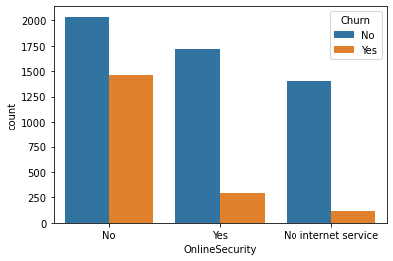
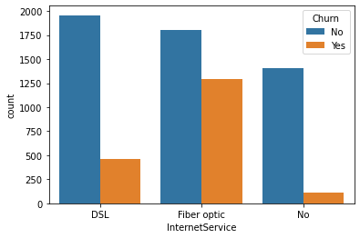
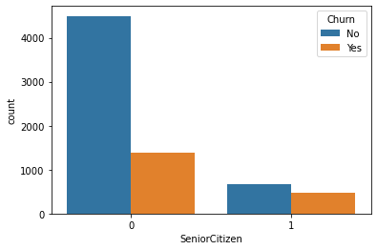
Univariate Analysis
We have analyzed all the features one by one with respect to churn rate and we have plotted 17 charts. Some initial insights we got are:
1. Senior Citizen Customers are more likely to churn with a churn rate of 41%.
2. Customers with no partner are more likely to churn with a churn rate of 33%.
3. Customers with no dependents are more likely to churn with a churn rate of 31%.
4. Customers with fiber optic internet service are more likely to churn with a churn rate of 42%.
5. Customers with no online security are more likely to churn with a churn rate of 42%.
6. Customers with no online backup are more likely to churn with a churn rate of 40%.
7. Customers with no device protection are more likely to churn with a churn rate of 39%.
8. Customers with no tech support are more likely to churn with a churn rate of 41%.
9. Customers who have month-to-month contracts are more likely to churn with a churn rate of 43%.
10. Customers who have paperless billing are more likely to churn with a churn rate of 33%.
11. Customers who make payments via electronic cheques are more likely to churn with a churn rate of 42%.
12. Customers having tenure between 1 to 12 months are more likely to churn with a churn rate of 48%.

Slide 8
Numerical Analysis

Slide 9
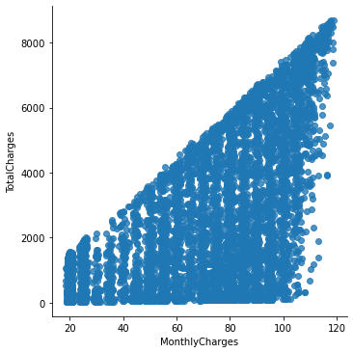
Monthly charges vs. Total charges
Findings:
1. There is a positive correlation between total charges and monthly charges.
2. Total Charges increase as Monthly Charges increase.

Slide 10
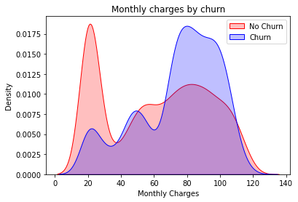
Monthly charges vs Churn
Findings:
Churn is high when Monthly Charges are high

Slide 11
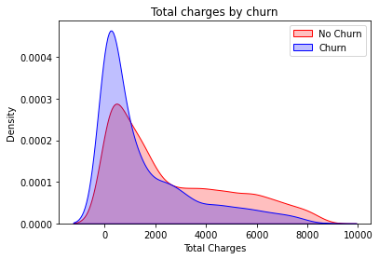
Total Charges vs churn
Findings:
Higher Churn at lower Total Charges

Slide 12
Analyzing 3 parameters
However, if we combine the insights of 3 parameters i.e. Tenure, Monthly Charges, and total Charges then the picture is a bit clear:- Higher Monthly Charges at lower tenure result in lower Total charges. Hence, all these 3 factors viz Higher Monthly Charge, Lower tenure, and Lower Total Charge are linked to High Churn.

Slide 13
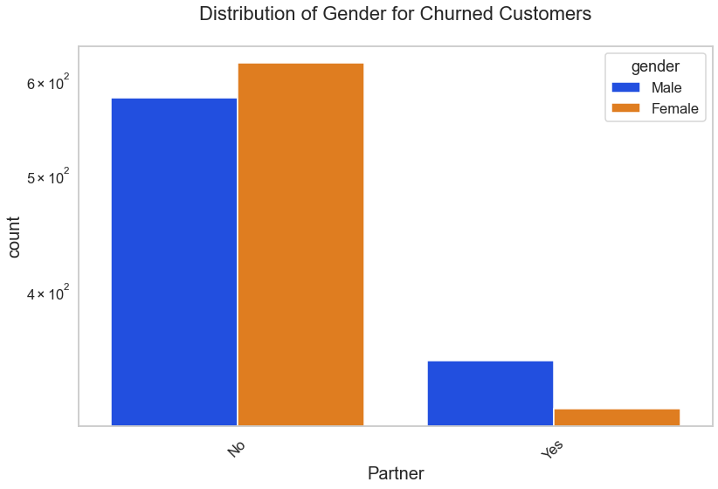
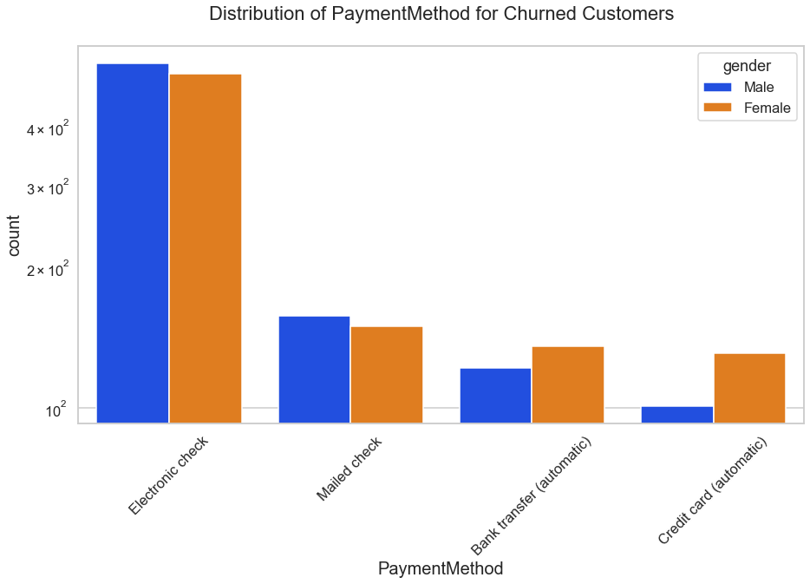
Bi-variate Analysis
Females who don't have partners or who are using credit cards for payments are more likely to churn.

Slide 14
Final Thoughts
1. Customers using payment methods such as electronic cheques are the highest churners.
2. Customers having Month to Month contracts are more likely to churn.
3. Customers with no online security or no tech support are more likely to churn.
4. Senior Citizens are more likely to churn with a churn rate of 42%.
5. People with no partners or no dependents are more likely to churn.
6. People with less tenure i.e... between 1 to 12 months are more like to churn.
7. Higher monthly charges, lower tenure, and lower total charges are high churners.
8. Females who don’t have partners or who are using credit cards for payments are more likely to churn.

Slide 15
Thank you

